Slide 1
Causes of the Civil War

Slide 2
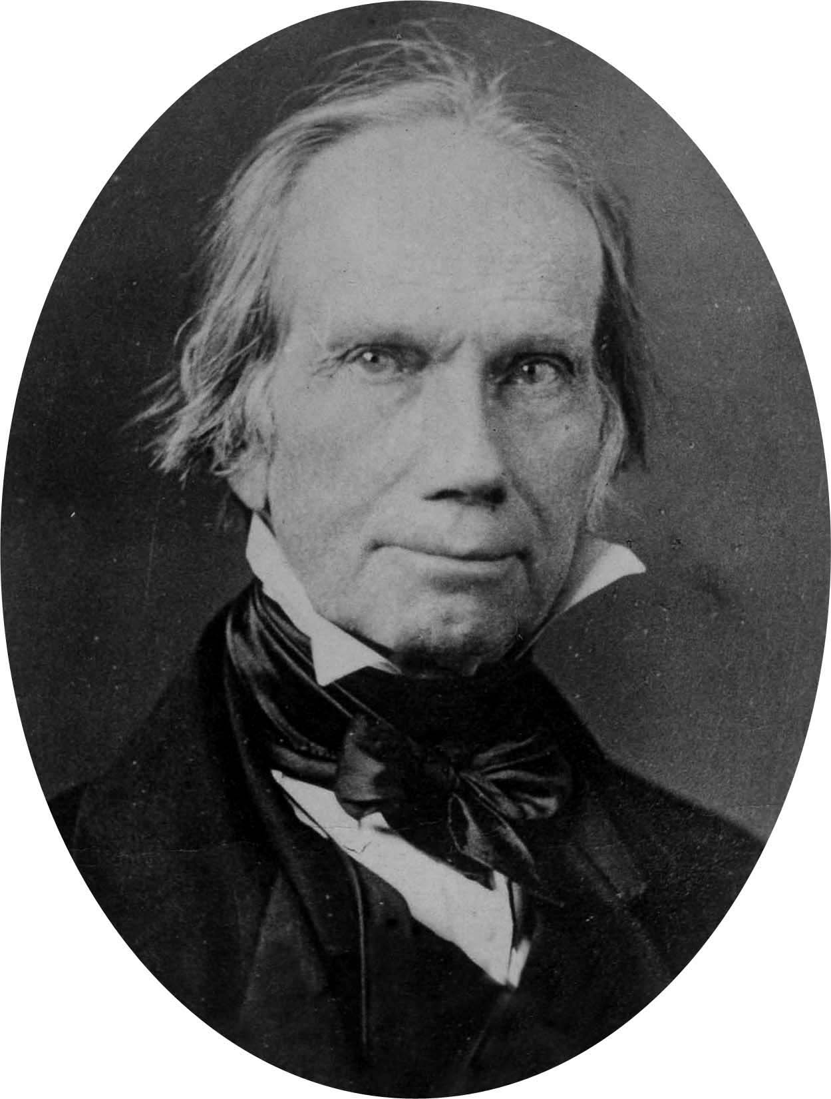
Missouri Compromise, 1820
US Slave Population: 1,538,000
Missouri Compromise: admits Missouri to be a slave state and Maine as a free state
Restricts slavery north of the 36th parallel.

Slide 3
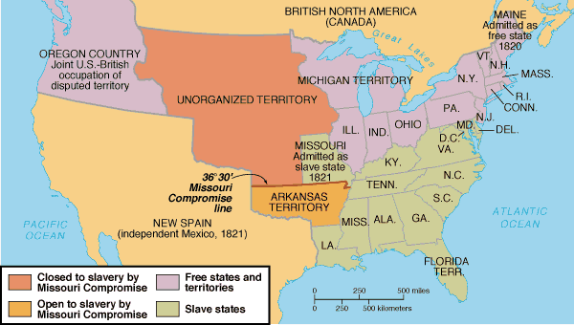
Map

Slide 4
Nullification Act, 1828
South Carolina passes the Nullification Act
Allows any state to void laws the Federal Government passed
States can ignore Congressional Law

Slide 5
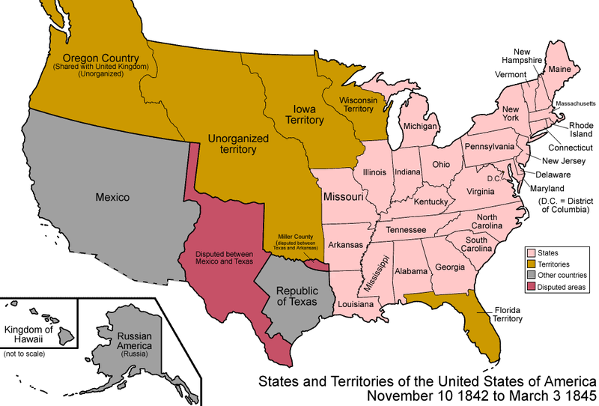
1840s
US Slave Population: 2,487,000
Mexican—American War
  Texas is annexed by the United States – essentially stolen from Mexico
  Treaty of Guadalupe Hidalgo: US gains California and New Mexico

Slide 6
Compromise of 1850
US Slave Population: 3,204,313
Compromise of 1850 is established to balance the power between pro and anti-slavery members of Congress
4 Major Points:
  1) Admit California as a Free State
  2) Prohibit Texas from expanding into New Mexico
  3) New Mexico and Utah citizens vote on slavery
  4) *Stronger Fugitive Slave Act

Slide 7
Kansas-Nebraska Act, 1854
Allows citizens of new states and territories to have the right to vote for or against slavery.
Northerners fear slavery will spread into the west and north

Slide 8
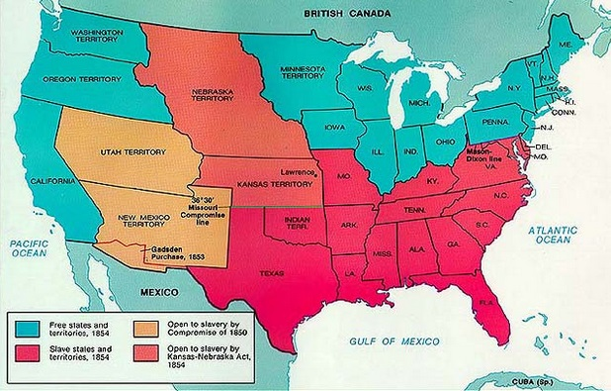
Kansas—Nebraska Act, 1854 map

Slide 9
Bleeding Kansas
Pro-Slavery Missourians known as Border-Ruffians move into Kansas
Anti-Slavery northerners known as Jayhawkers move into Kansas as well
Armed fighting results in 200 deaths
Kansas elects two legislatures, one pro-slavery and one anti-slavery; neither is legitimate

Slide 10
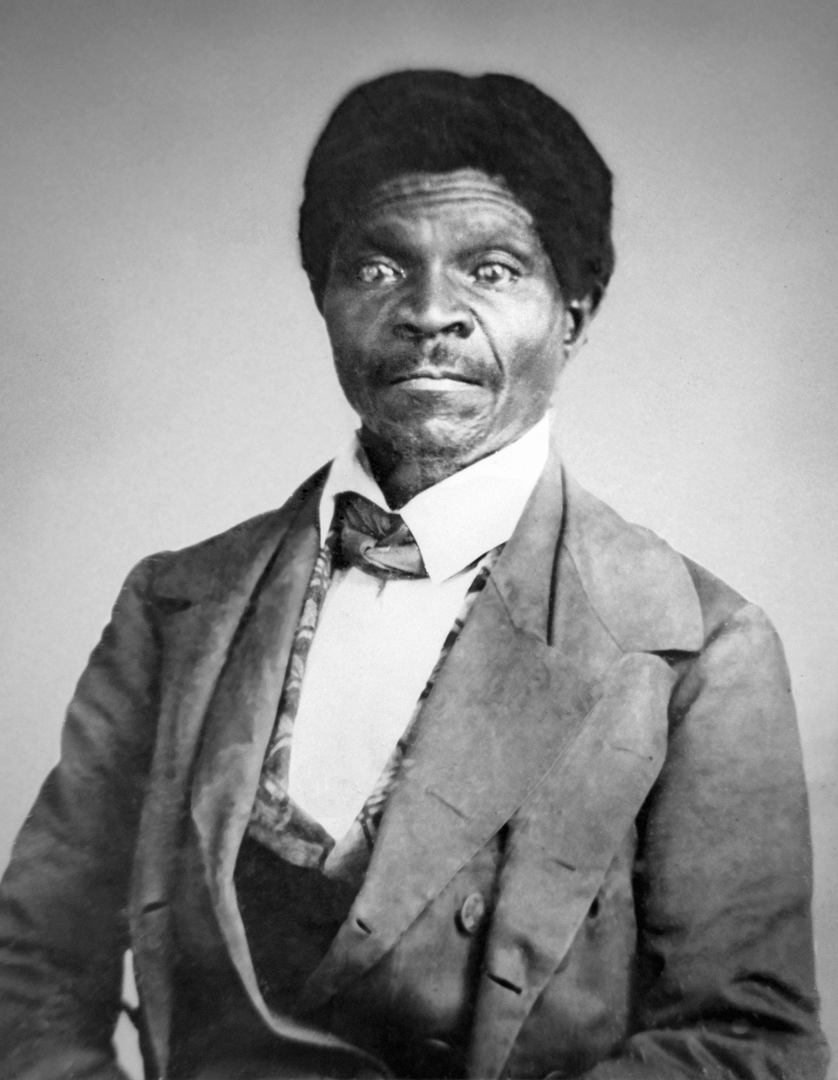
Dred Scott v. Sandford
Supreme Court rules that slaves are considered property
They have no rights in any territory or state
Essentially the ruling expands slavery to all territory and states

Slide 11
Oregon, 1859
Oregon admitted as a free state
Prohibits any person of African descent from living there
This language was NOT removed from the state Constitution until 2007…
Meanwhile…
John Brown, a white abolitionist, attempts to arm slaves in Virginia by capturing weapons at Harper’s Ferry, VA
He is captured and hanged – no slaves joined his revolt.

Slide 12
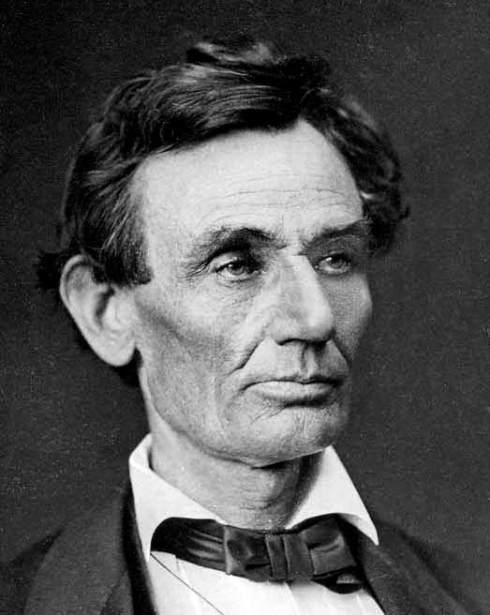
Election of 1860
US Slave Population: 3,954,174
Nearly 1 out of every 7 people was owned by another
Abraham Lincoln is elected for the Republican Party

Slide 13
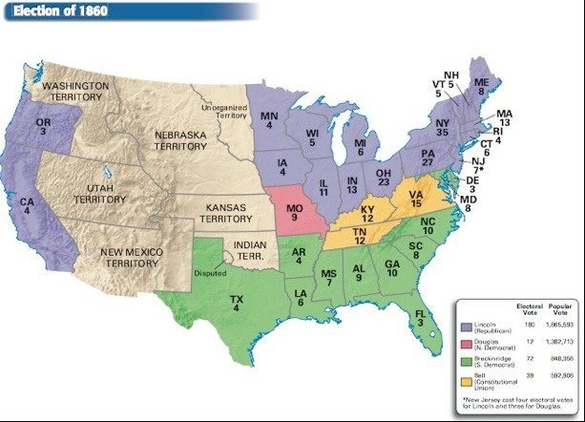
Election Results, 1860

Slide 14
Republican Party Wins
November 6: Lincoln is elected President, largely by carrying the northern states.
He promises that slavery will not be extended to any territories in the United States, but it will not be restricted in any state that currently holds slaves.
He tried to be a moderate, but also had some pretty ridiculous ideas about Black people and slaves.

Slide 15
December 17, 1860
South Carolina votes to secede from the United States, followed by:
Jan 9, 1861: Mississippi (add this in)
Jan 10, 1861: Florida
Jan 11, 1861: Alabama
Jan 19, 1861: Georgia
Jan 26, 1861: Louisiana
March 2, 1861: Texas
April 17, 1861: Virginia (following attack on Ft. Sumter)
May 6, 1861: Arkansas
May 20, 1861: North Carolina
June 8, 1861: Tennessee

